Slide 1
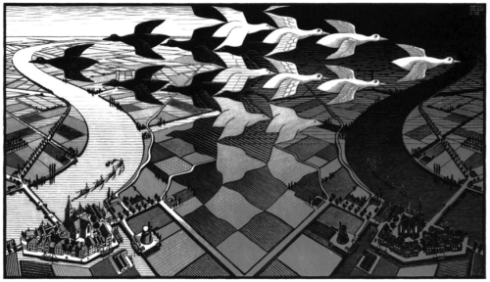
Modeling Change
Mathematically speaking…
by Pavel Gladyshev

Slide 2
Last homework discussion
Lee
Ahmed

Slide 3
Intuitive concept of state
World is a collection of interacting objects
Society
Pebbles on the beach
Cars in traffic
Objects & their properties change over time
State is a snapshot of the world at an instant
State can be modeled mathematically.

Slide 4
A difficulty: modeling change
There is no implicit notion of time and change in mathematics.
All math definitions stay the same forever
Time and change need to be modeled using functions.
Two key ideas:
State = function (time)
New state = Old state + update

Slide 5
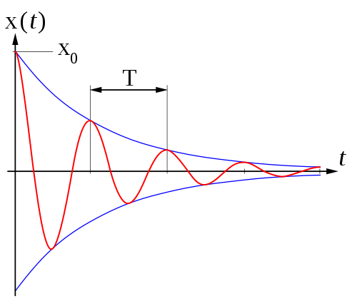
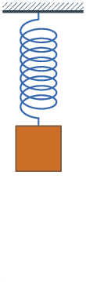
Oscillation of a pendulum as a function of time

Slide 6
Political views of a person as a function of time
views(human,time) → political views of the particular
person at a moment in time

Slide 7
Political views of Roman Abramovich as a function of time
P
views( “Roman Abramovich”, time)
Capitalist
Communist
R
1991

Slide 8
State change as a sequence of state updates
Sometimes it is hard to define state as a algebraic formula of time:
Oscillation of a pendulum with several pushes
Positions of balls on a billiard table after a strike
Behaviur of an interactive computer system
In such cases, the state change over time is calculated as a sequence of instantaneous state updates.

Slide 9
Differential equation
Newton's Law of Cooling states that the rate of change of the temperature of an object is proportional to the difference between its own temperature and the ambient temperature:
T – temperature, t - time

Slide 10
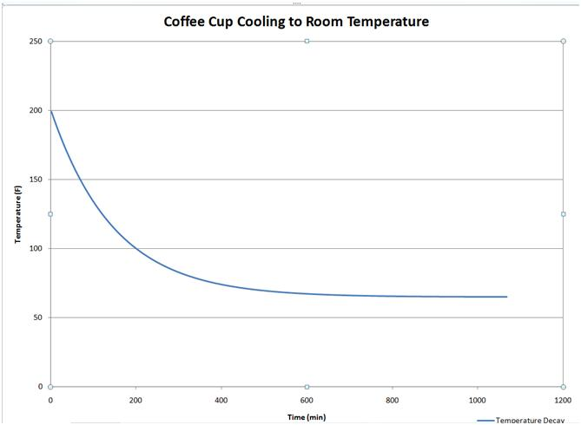
slope
T₀
T₁
T_{room}
t₀ t₁

Slide 11
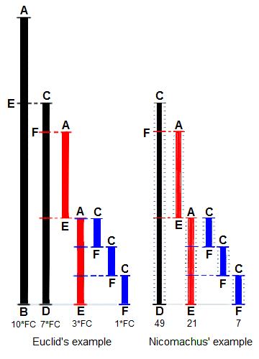
Computing Greatest Common Divisor
gcd(a,b) – largest number that divides both a and b

Slide 12
gcd(a,b)
yes
1
a=0
function gcd(a, b)
if a = 0
return b
while b ≠ 0
if a > b
a := a − b
else
b := b − a
return a
yes
2
b=0
4
5
r := a
r := b
3
a>b
6
7
yes
b:=b-a
a:=a-b
8
halt
Computer stays halt

Slide 13
State
a, b – non-negative integers
ip – instruction pointer: the number of the next command to be executed {1,2,3,4,5,6,7,8}
r - result

Slide 14
Change of state (transition function)
gcd(a,b)
yes
1
a=0
b=0
yes
2
4
5
r := a
r := b
3
a>b
6
7
yes
b:=b-a
a:=a-b
8
halt
Computer stays halt

Slide 15
gcd(a,b)
yes
1
a=0
b=0
yes
2
4
5
r := a
r := b
3
a>b
6
7
yes
b:=b-a
a:=a-b
8
halt
Computer stays halt

Slide 16
Computation example: Initial state = (2,1,1,0)

Slide 17
Termination proof
One of the key properties of a useful program is that it does not hang when given valid input
This is known as proof of termination: i.e. proof that for all valid inputs the program eventually reaches a final state

Slide 18
Homework
Think (and post in the forum) how you could formally define a computation of f() ?
Think (and post in the forum) how would you go about proving that for all initial states of the form (a,b,1,0), where a>0, b>0, every computation of f() reaches a state with ip=8 in a finite number of steps?

